Slide 1
Sentiment Analysis for IMDB Movie Reviews

Slide 2
INTRODUCTION

Slide 3
INTRODUCTION
Sentiment analysis is a natural language processing technique used to identify and extract subjective information from text, such as opinions, attitudes, emotions, and feelings.
We use machine learning algorithms to automatically classify text into categories such as positive, negative, or neutral based on the underlying sentiment expressed.

Slide 4
PROBLEM STATEMENT
Using Internet Movie DataBase (IMDB) reviews of movies, we analysis the reviews and categorize them into positive and negative using sentiment analysis
Through sentiment analysis we will be able to understand a wider public opinion and quickly gauge their attitudes based on negative and positive feedback.

Slide 5
ROADMAP
Data Collection
Exploratory Data Analysis
Model Comparison
1
3
5
2
4
6
Data cleaning and preprocessing
Feature Engineering
Model Selection

Slide 6
DATA ANALYSIS

Slide 7
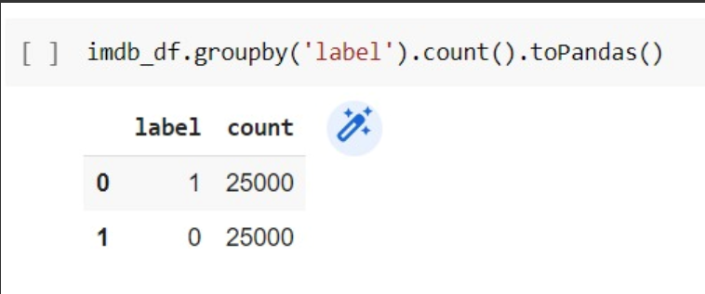
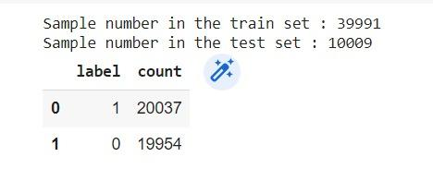
DATASET
SOURCE
http://ai.stanford.edu/~amaas/data/sentiment/
Large Review Movie Dataset
Dimensions- 2x50000
Features-Review, Sentiment
Models implemented
Decision Tree
Logistic regression
Random Forest
Naïve Bayes
Gradient Boosting

Slide 8
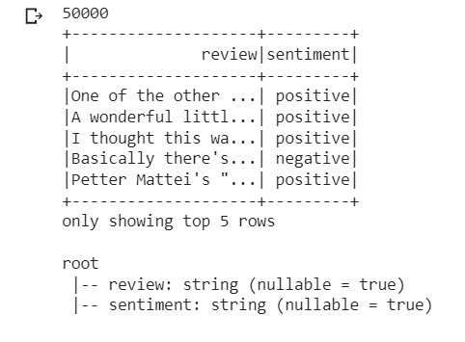
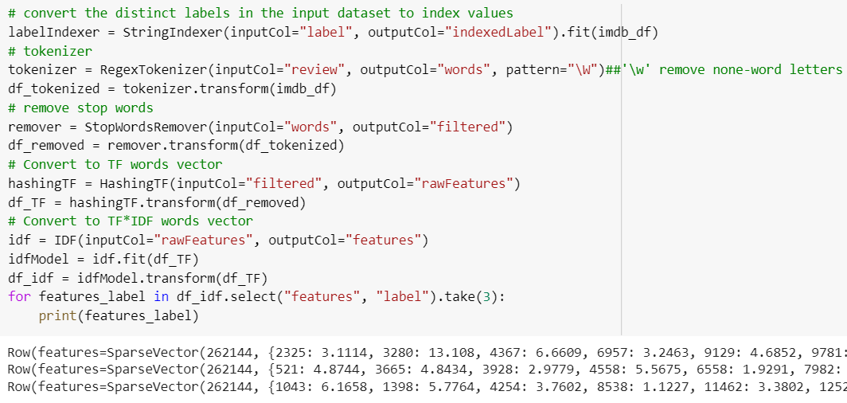
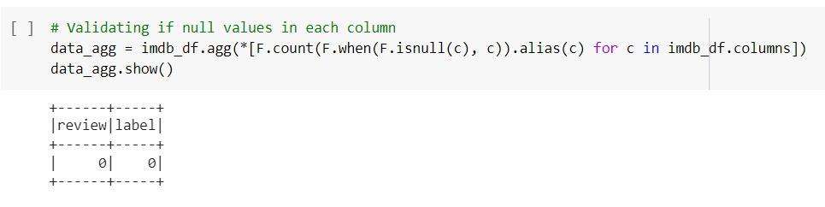
EXPLORATORY DATA ANALYSIS
Print Schema
Feature Engineering
Null Analysis

Slide 9
CODE ANALYSIS

Slide 10
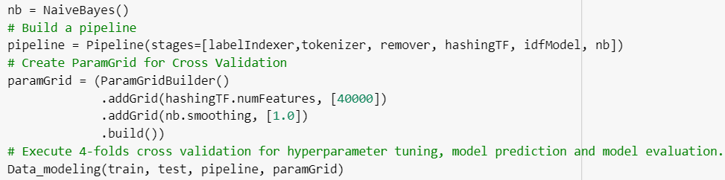
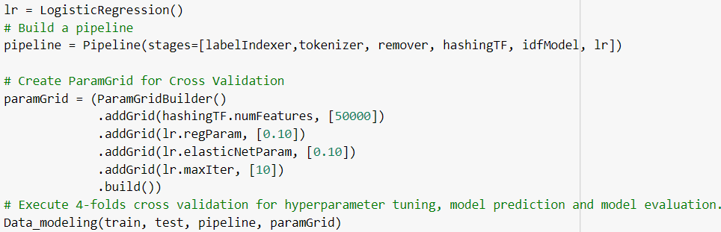
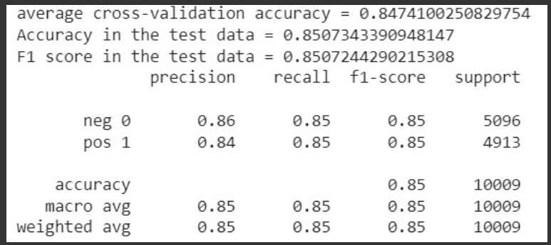
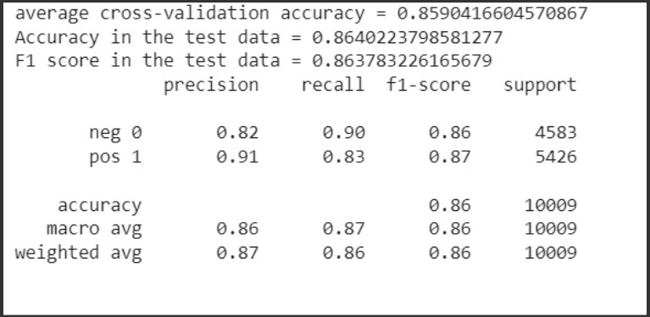
NAIVE BAYES It calculates the probability of a text belonging to a particular sentiment class based on the occurrence of words in that text. It assumes that the occurrence of words in a text are independent of each other.
LOGISTIC REGRESSION A linear function is used to map the input features to a probability score, which is then passed through a sigmoid function to obtain the final predicted probability.

Slide 11
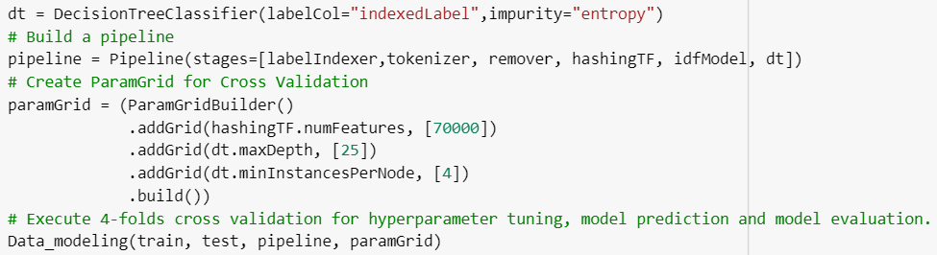
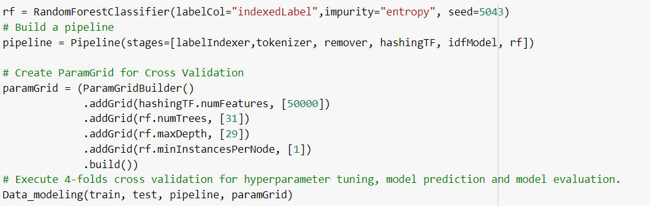
DECISION TREE
Decision tree is constructed by recursively splitting the dataset into subsets based on the most significant attributes or features. The goal is to create a tree that classifies sentiment into positive, negative
Best Parameter: 70000
Max Depth 25
Min Instance: 4
Accuracy: 78.25%
RANDOM FOREST
The random forest algorithm works by constructing decision trees in a randomized way and combining their outputs to make a final prediction.
Best Parameter: 50000
Max Depth 29
Min Instance: 1
Accuracy: 81.25%

Slide 12
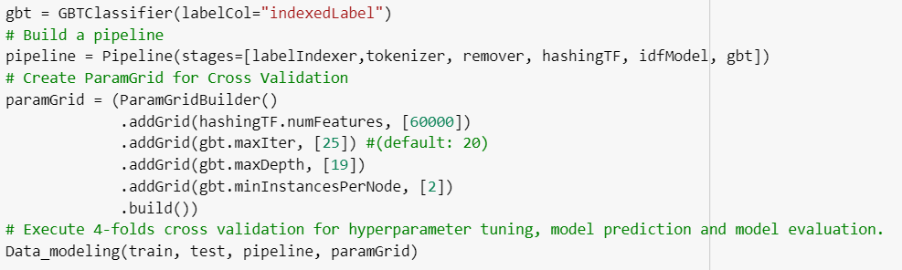
GRADIENT BOOST
Gradient Boosting sequentially adds new models to the ensemble, where each new model attempts to correct the errors made by the previous models. It is an ensemble method that combines multiple weak learners to create a strong learner.
Best Parameter: 60000
Max Depth 19
Min Instance: 2
Accuracy: 82.29%

Slide 13
OUTPUT ANALYSIS

Slide 14
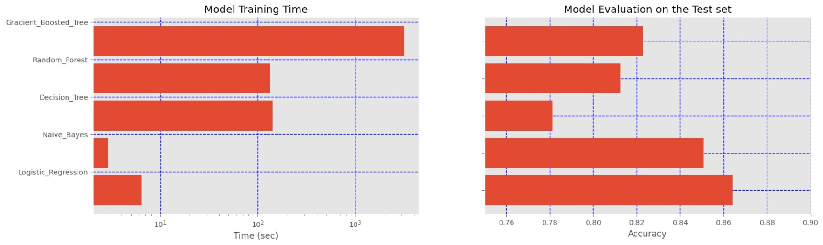
OUTPUT

Slide 15
CONCLUSION

Slide 16
THANK YOU

